Slide 1

$
E-COMMERCE AND
SOCIAL COMMERCE
$0.00
ADD TO CART

Slide 2

Submitted By
Ma
Name : MahmuMdaul Hasan Sarkar
Name : MD. SaMmaiul Alam Sakafi
Registration No1: 19502004643
Session : 20M1a9-2020
Registration No1: 19502004689
Session : 20M1a9-2020
Department of Computer Science and Engineering (CSE)
Ma
Institute of Science and Technology (IST)
21-11-2024

Slide 3

Submitted To
Ma
Supervisor Name : Saleh Muhammad Maruf
Ma
Assistant Professor
Department of Computer Science and Engineering (CSE)
Ma
Institute of Science and Technology (IST)

Slide 4

TABLE OF CONTENT
1 INTRODUCTION
2 MOTIVATION
5 EXISTING SYSTEM FEATURES
6 PROPOSED SYSTEM DESIGN
3
OBJECTIVE
7
PROPOSED SYSTEM FEATURES
CONCLUSION
4 EXISTING SYSTEM DESIGN
8

Slide 5

INTRODUCTION
E-commerce: E-commerce is the buying and selling of goods or
services over the Internet. It is a new dimension of business that
has reduced geographical limitations.
$
Social Commerce: Social commerce is buying and selling products
or services using social media platforms. It enables users to
browse, discover, and purchase products directly through social
networks. Platforms like Facebook, Instagram, TikTok, etc., are
popular mediums for social commerce.
$
Our E-commerce and Social Commerce platform aims to
transform online shopping in Bangladesh by creating a seamless
and efficient connection between buyers and sellers. By focusing
on user-friendly design, real-time communication, secure
transactions, and personalized recommendations, we strive to
enhance the shopping experience. Through cutting-edge
technology and innovative features, we seek to empower local
businesses, drive customer satisfaction, and foster growth in the
digital economy.

Slide 6

MOTIVATION
Our Vision and Goal
Social Proof
Community Driven Experiences
Visual Inspiration
Increasing Demand for Personalization

Slide 7

OBJECTIVE
Integrate E-commerce and
Social Commerce
Enhance User Experience
Increase Trust and Credibility
Bridge the Gap Between Social Media and E-commerce
Boost Business Efficiency

Slide 8
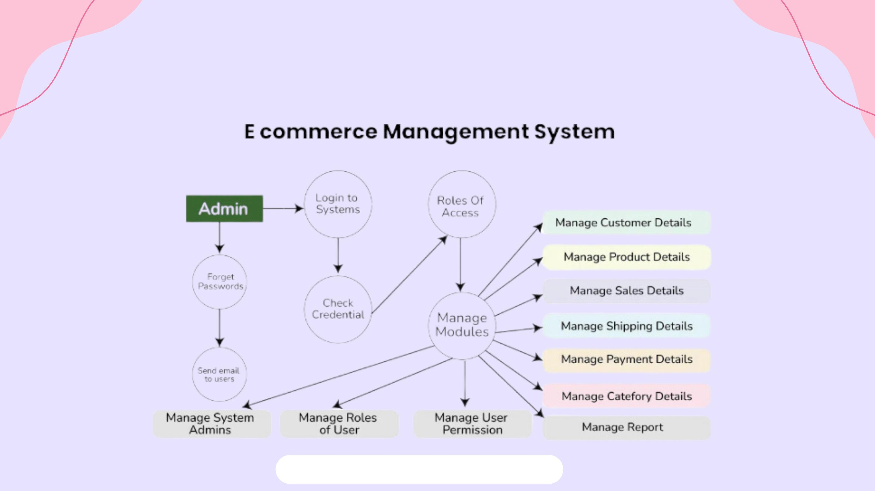
EXISTING SYSTEM DESIGN
Reference: geeksforgeeks

Slide 9

EXISTING SYSTEM FEATURES
User Information: Flow of user registration and login data to the
website system.
Product Listings: Transfer of product information from the database to
the website interface for users to browse.
Order Placement: Submission of orders by users to purchase products.
Payment Processing: Flow of payment data from users to the payment
gateway for transaction processing.
Order Fulfillment: Transmission of order details from the website
system to the warehouse or fulfillment center for processing.
Shipping Information: Transfer of shipping details from the warehouse
to the shipping carrier for delivery.
Feedback and Reviews: Exchange of feedback and reviews between
users and the website system to improve product and service quality.
Reference: geeksforgeeks

Slide 10
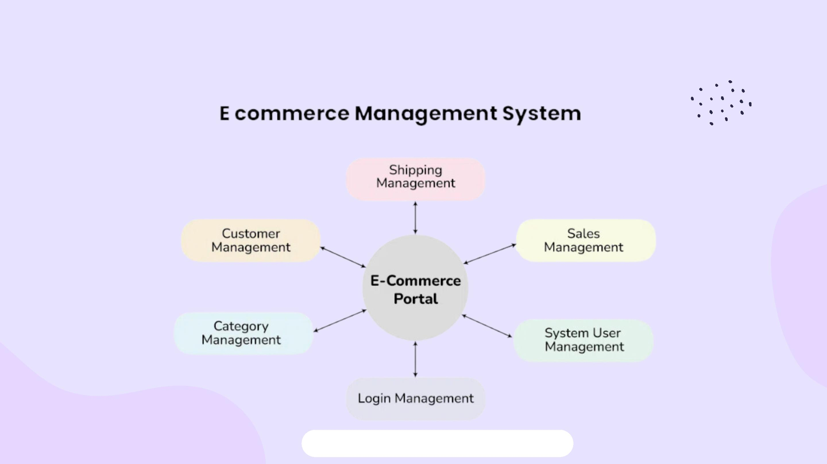
PROPOSED SYSTEM DESIGN

Slide 11

PROPOSED SYSTEM FEATURES
Here are some interesting project ideas for an e-commerce and social e-
commerce platform:
Personalized Product Recommendations Platform
Social Media-Integrated E-Commerce Platform
Influencer-Driven Social Shopping App
Community-Based Review and Rating Platform
Virtual Try-On and Augmented Reality Shopping
Collaborative Shopping Cart Platform
Live Video Shopping Experience
Sustainable and Ethical Shopping Platform
Subscription-Based Social E-Commerce Platform
Flash Sales & Group Buying Platform

Slide 12

CONCLUSION
Seamless Integration of Social Commerce and E-commerce:
The proposed system successfully bridges the gap between social media and
traditional e-commerce, enabling a more interactive and engaging shopping
experience for users.
Enhanced User Engagement and Trust:
By incorporating features like personalized recommendations, user reviews, and
social sharing, the platform fosters greater customer interaction and builds trust
among users.
Improved Business Outcomes:
Businesses can benefit from increased visibility, better customer insights, and
higher sales conversions by leveraging the power of social commerce features.
Future-proof Solution:
As social media continues to influence purchasing decisions, this platform
positions itself as a modern and scalable solution to meet the demands of
evolving consumer behavior.

Slide 13

THANK YOU

